Slide 1
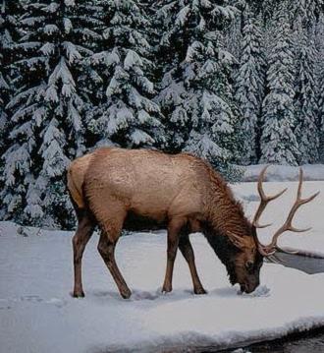
Comparative Study of Flora and Fauna in Gujarat and Jammu & Kashmir

Slide 2
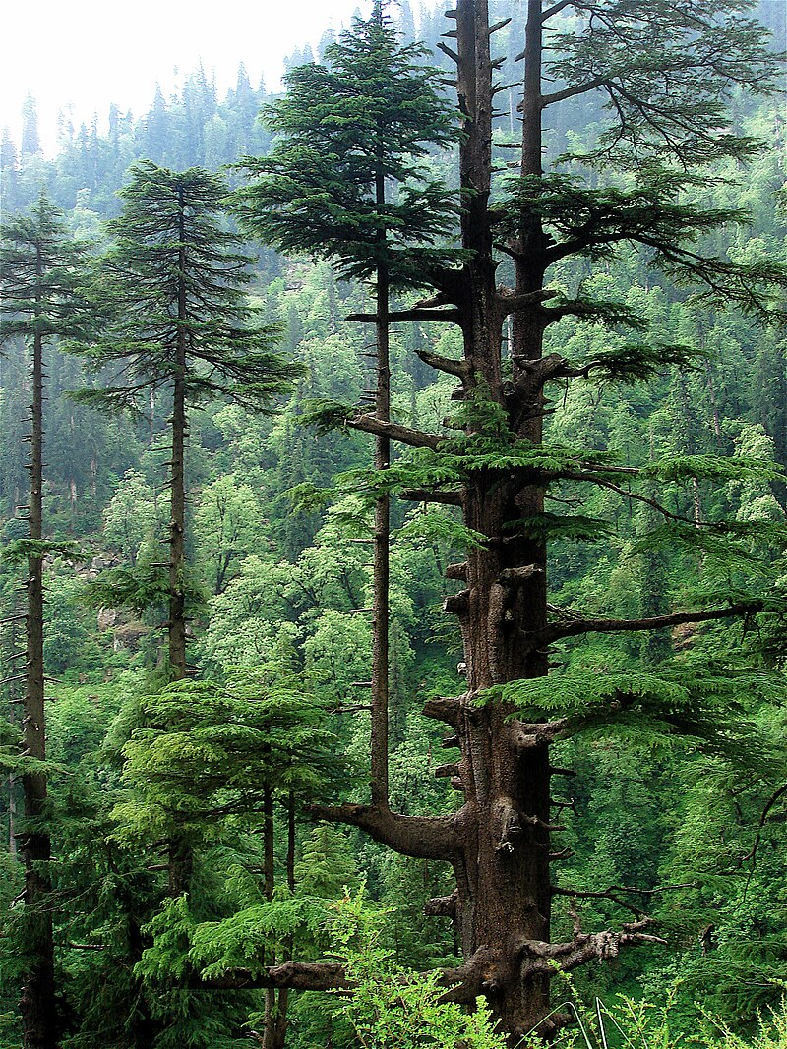
AGENDA
Geography and Climate
Flora and Fauna in Jammu & Kashmir
Flora and Fauna in Gujarat
Conservation Efforts
Comparative Summary

Slide 3
Geography and climate
Jammu & Kashmir
Northern India, Himalayan Region
Cold Climate
Gujarat
Western India, Coastal And Dry Region
Hot Climate

Slide 4
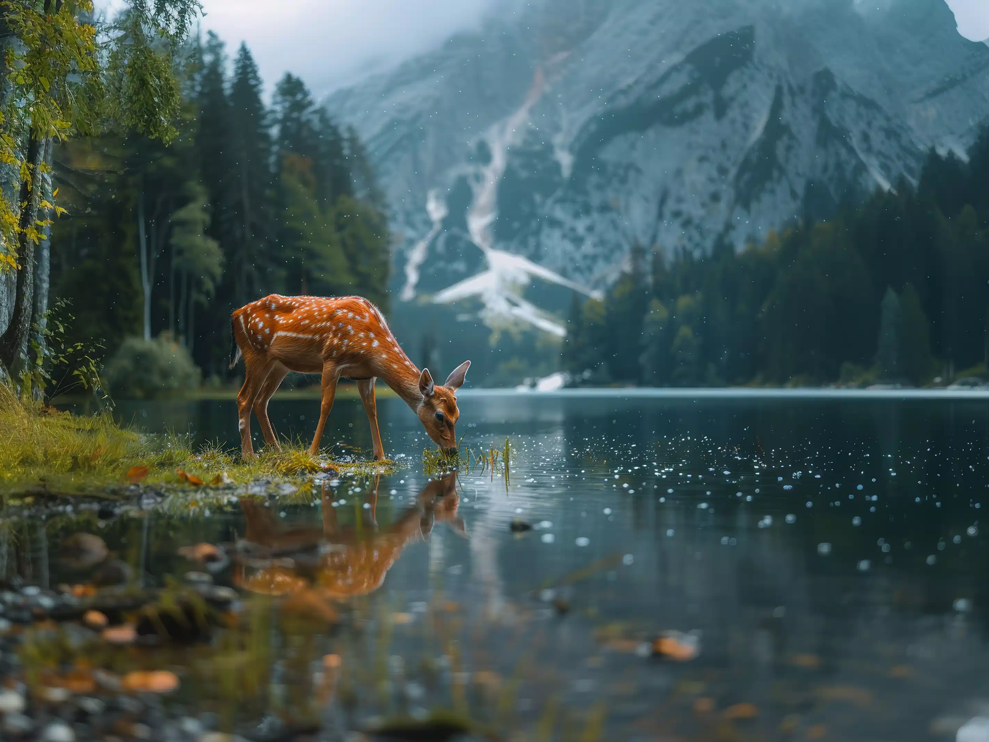
JAMMU & KASHMIR
Flora and Fauna
In

Slide 5
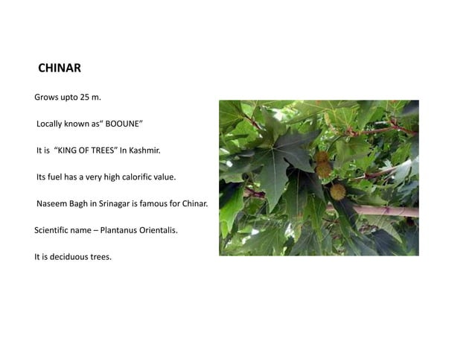
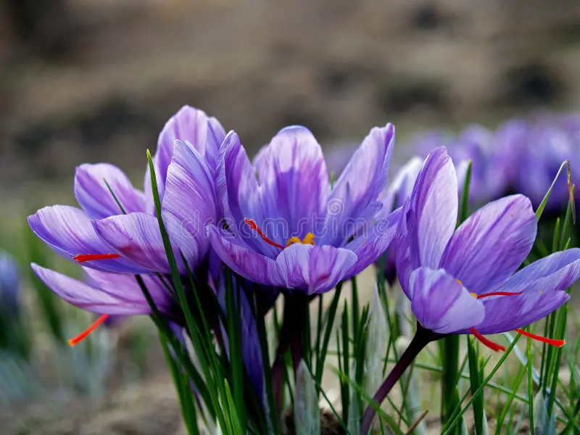
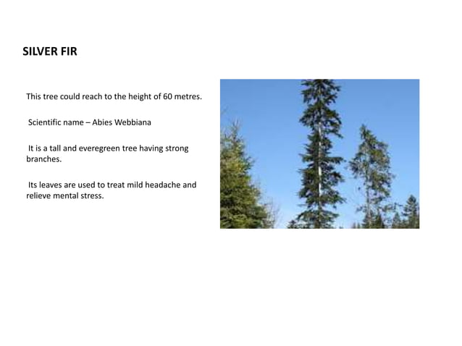
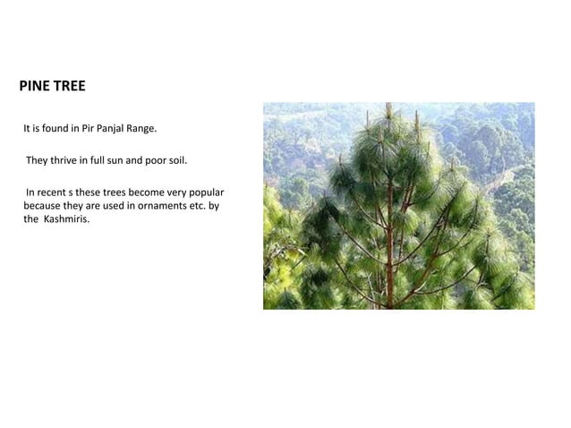
Flora
Forests
Coniferous Forests - These forests are found at higher altitudes and include species like Pine, Cedar (Deodar), Fir, and Spruce.
Broadleaf Forests - These are found at lower altitudes and consist of trees like Chinar, Poplar, and Willow.
Alpine Vegetation - At even higher altitudes, you'll find alpine meadows with grasses and shrubs, along with medicinal plants.
Flowers and Orchids
The region is famous for its variety of flowers, including tulips, lilies, and roses.
There are also several species of wild orchids.

Slide 6
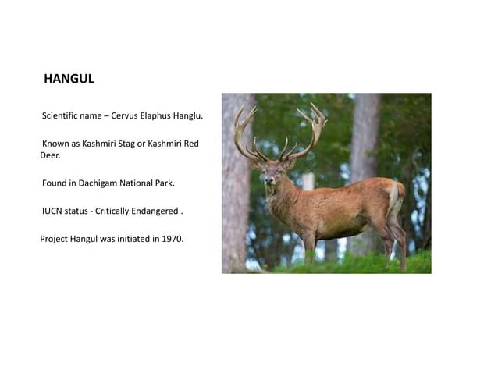
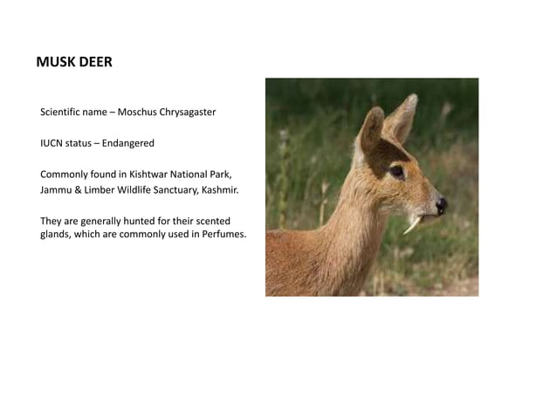
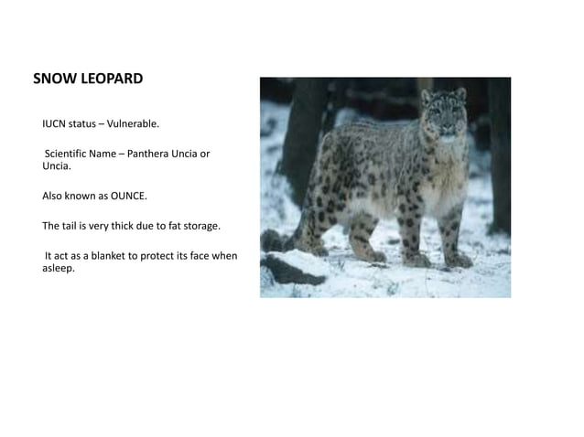
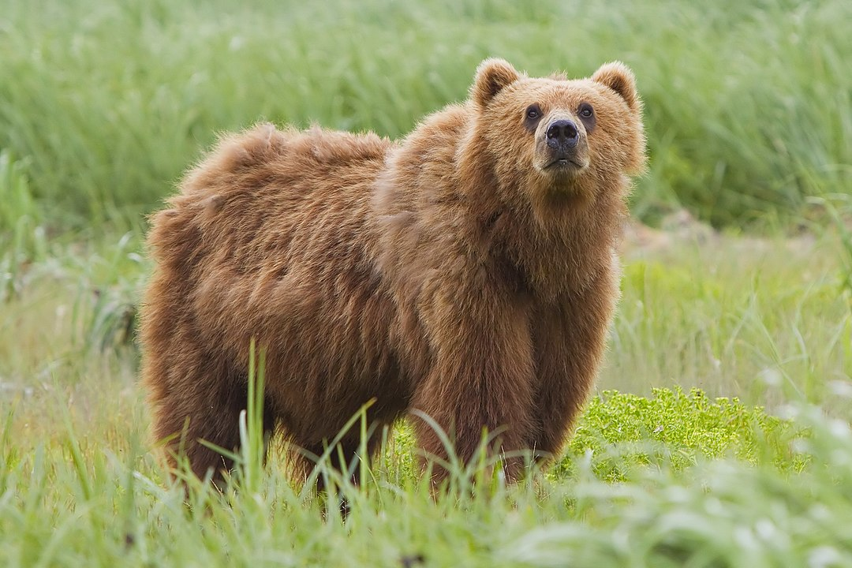
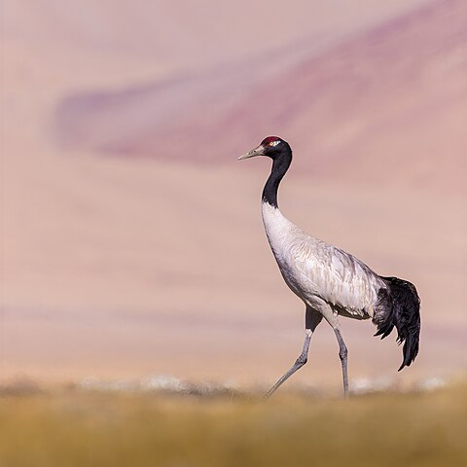
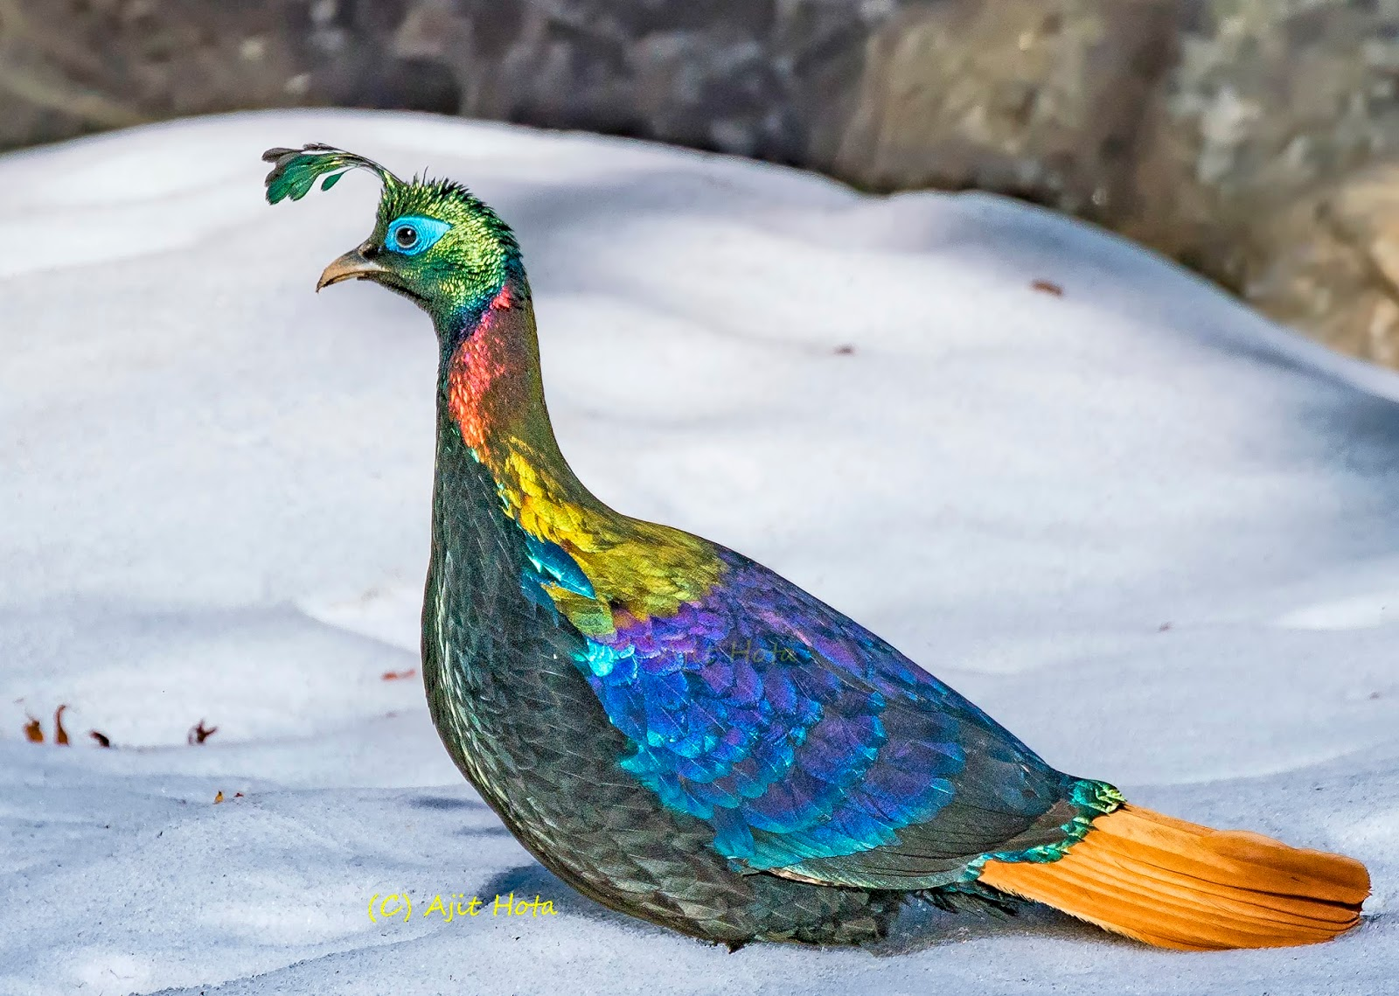
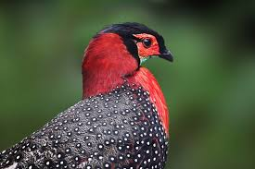
fauna
Mammals
Kashmir Stag (Hangul): An endangered species found in Dachigam National Park.
Snow Leopard: Found in the high-altitude regions.
Himalayan Black Bear and Brown Bear: Found in forested and mountainous areas.
Himalayan Musk Deer and Ibex: Found in higher altitudes.
Birds
Jammu and Kashmir are a birdwatcher's paradise with species like the Black-necked Crane, Himalayan Monal, and Western Tragopan.
Wetlands like the Hokersar and Wular Lake attract many migratory birds such as the Siberian Crane and various species of ducks.

Slide 7
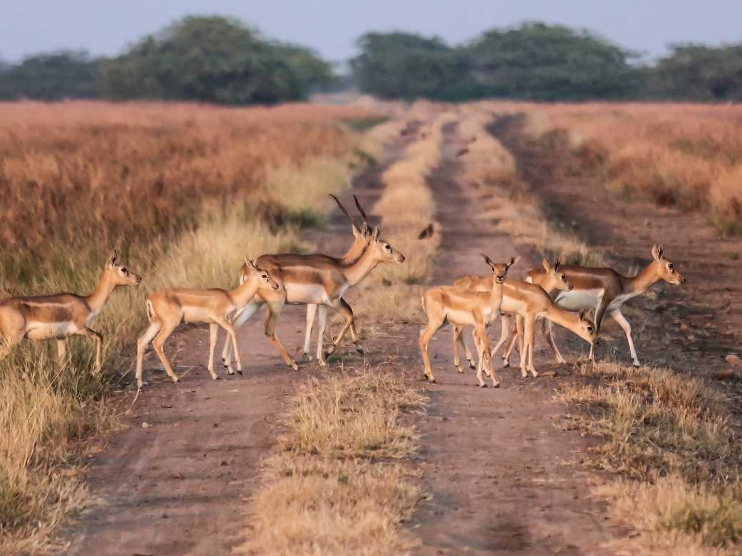
GUJARAT
Flora and Fauna
In

Slide 8
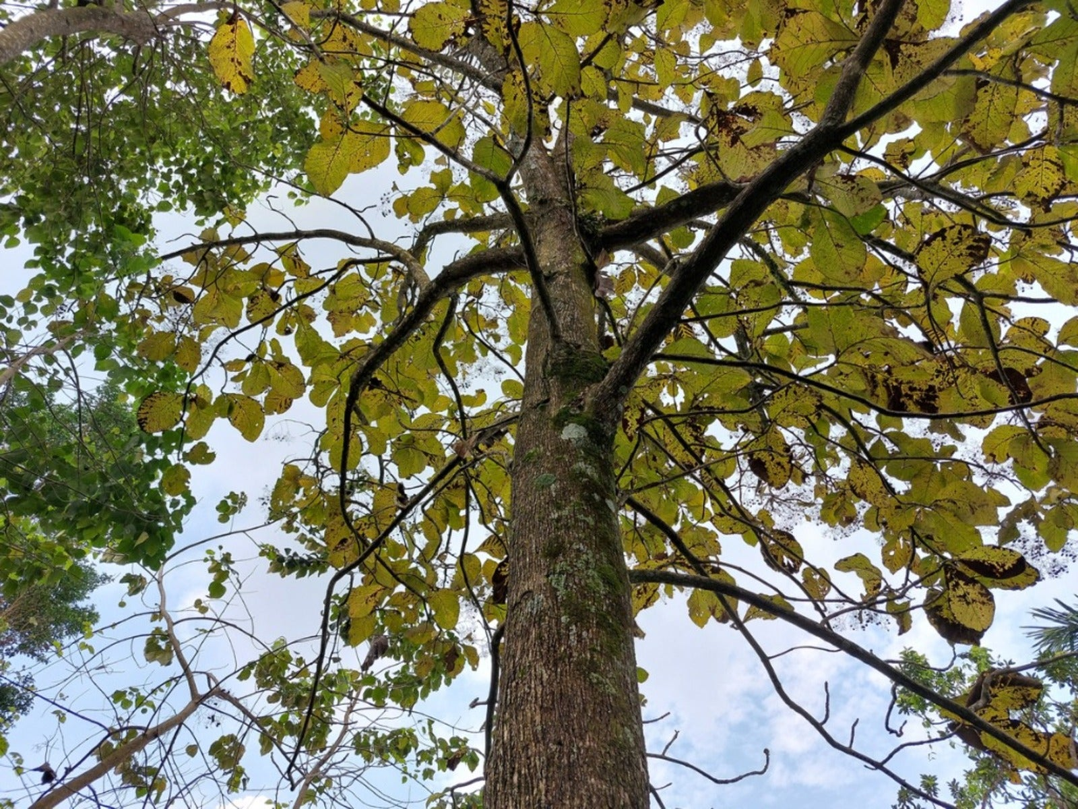
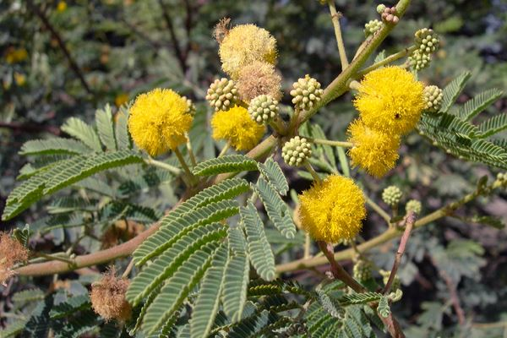
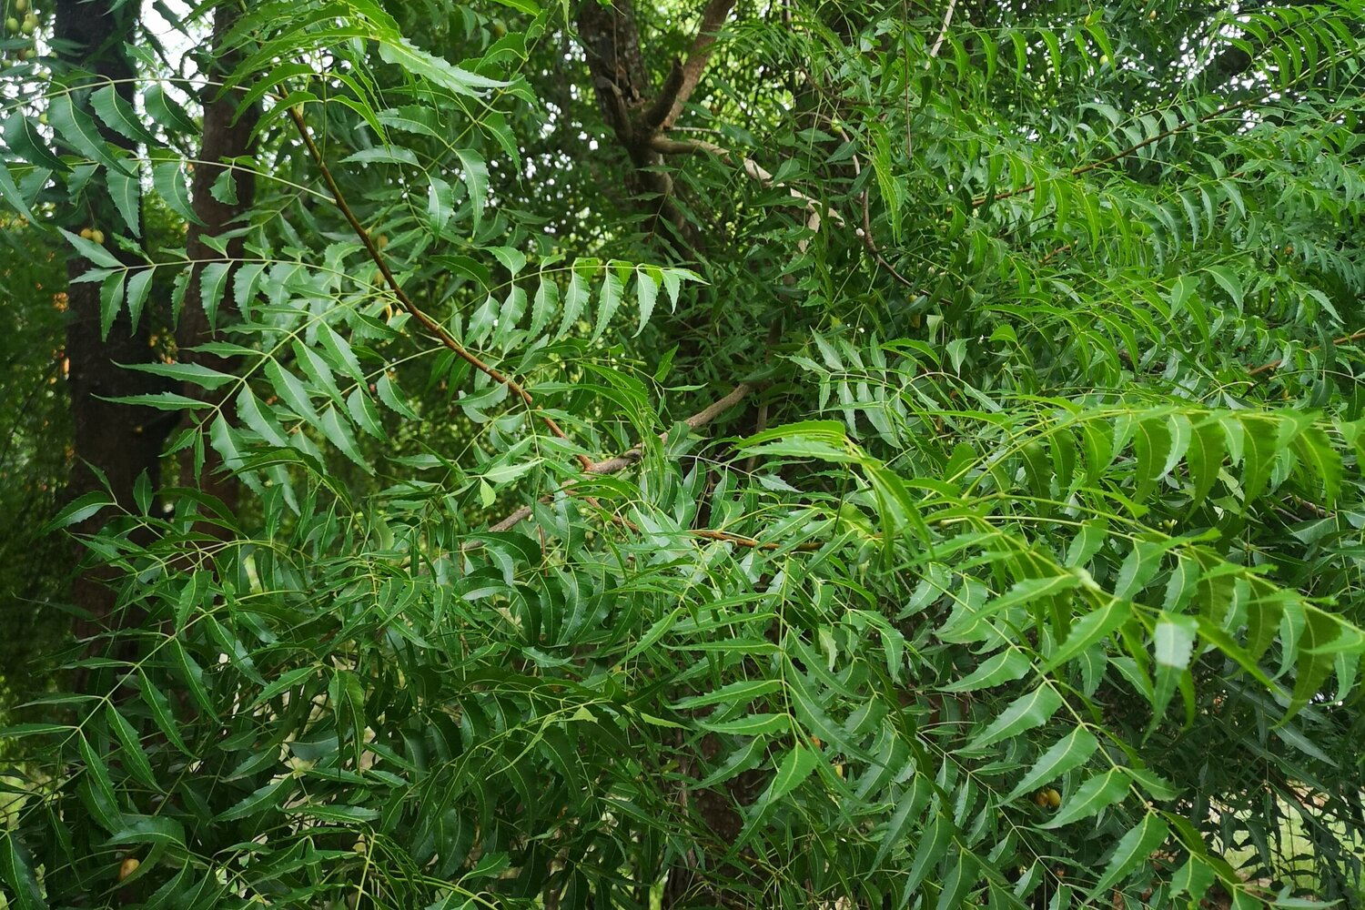
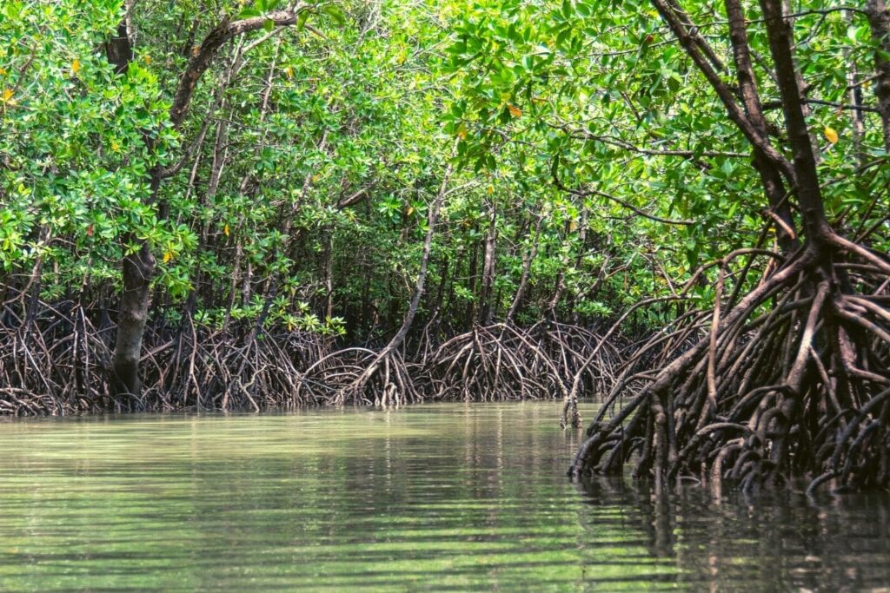
FLORA
Forests : Gujarat has a mix of deciduous and thorn forests. Prominent forest types include tropical dry deciduous forests, thorn forests, and mangroves.
Grasslands : The Banni Grasslands in the Kutch region are one of the largest grasslands in India.
Mangroves : Found mainly in the coastal areas, particularly in the Gulf of Kutch.
Desert Vegetation: The Rann of Kutch has salt-tolerant vegetation, including scrubby bushes and grass species.

Slide 9
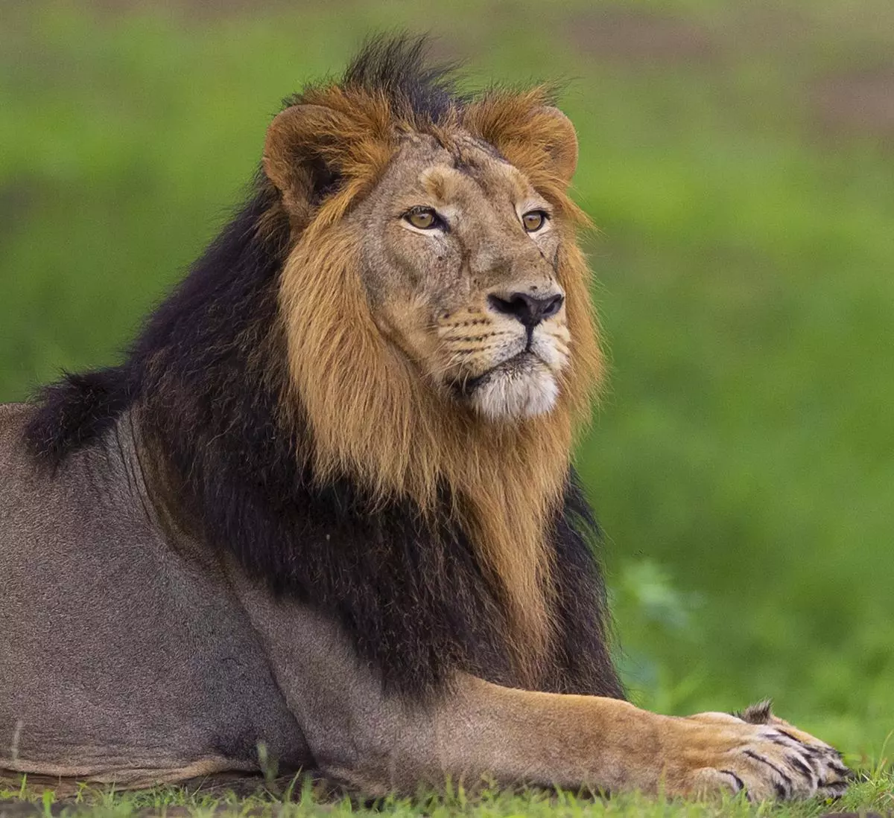
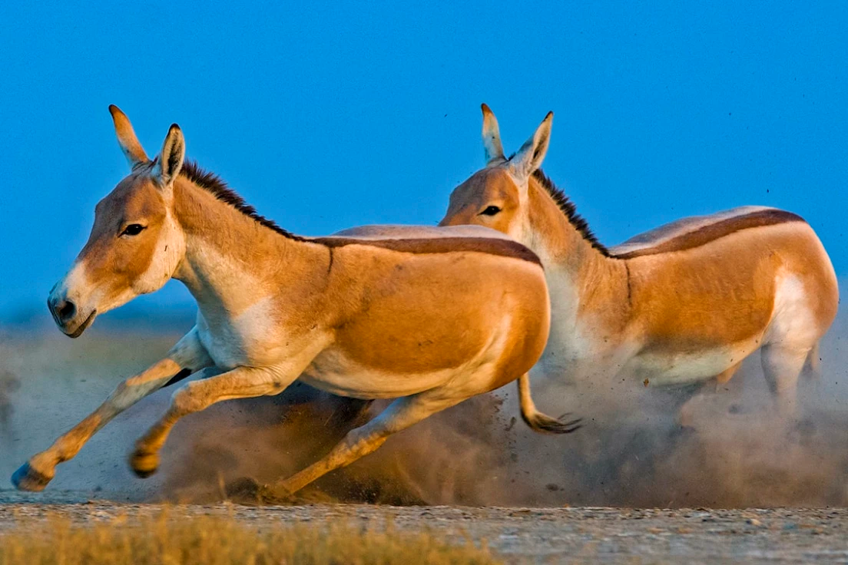
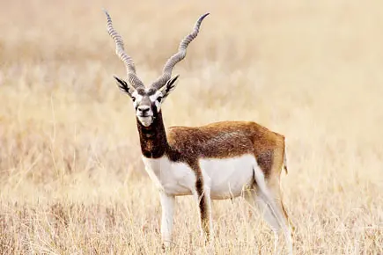
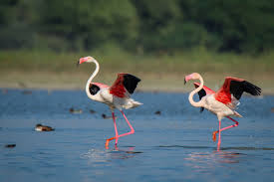
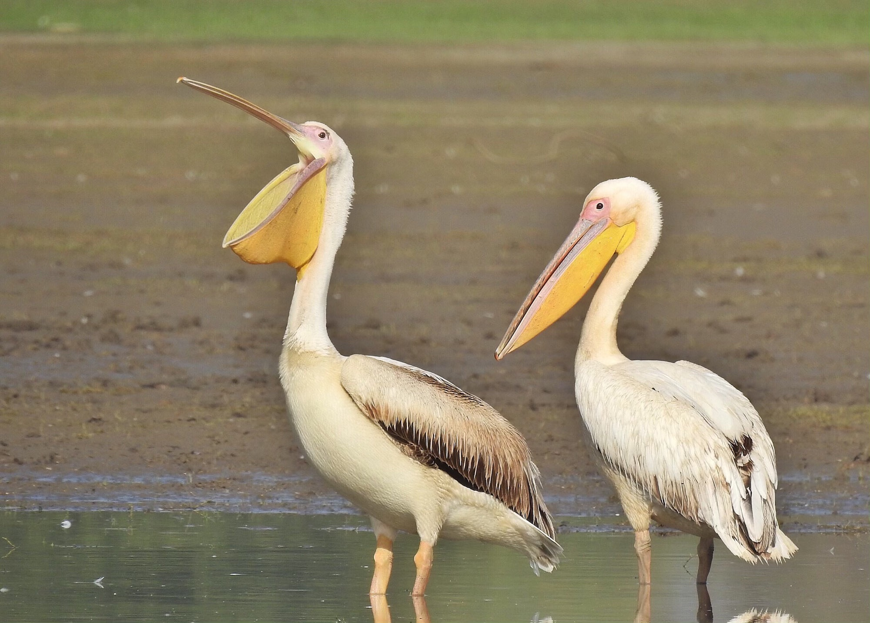
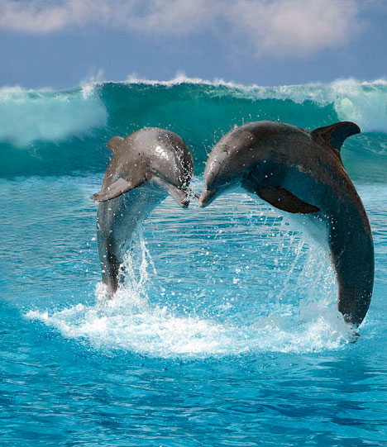
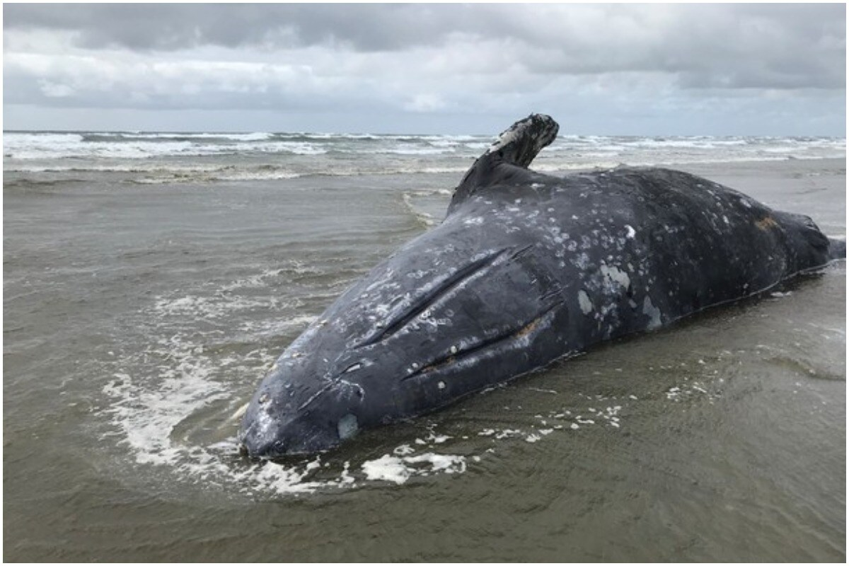
fauna
Asiatic Lions: The Gir National Park is the only place in the world where Asiatic lions can be found in the wild.
Leopards: Commonly found in several forested areas of Gujarat.
Birds: Gujarat is a paradise for bird watchers with species like flamingos, pelicans, cranes, and various migratory birds visiting the wetlands, including Nal Sarovar Bird Sanctuary and Khijadiya Bird Sanctuary.
Marine Life: The coastal areas, especially in the Gulf of Kutch, are rich in marine biodiversity, including coral reefs, dolphins, and whale sharks.
Blackbuck: These are found in the Velavadar National Park.

Slide 10
CONSERVATION EFFORTS
Jammu and Kashmir
National Parks and Sanctuaries: Dachigam National Park, Hemis National Park, and Kishtwar High Altitude National Park are key protected areas.
Wildlife Reserves: These include the Gulmarg Biosphere Reserve, Limber Wildlife Sanctuary, and Overa-Aru Wildlife Sanctuary.
Gujarat
Protecting Asiatic lions in Gir National Park and exploring translocation projects., preserving bird habitats in Nal Sarovar and Khijadiya Bird Sanctuaries.
Habitat Restoration :Large-scale mangrove planting in the Gulf of Kutch., ecological restoration of Banni Grasslands.
Protecting and restoring marine ecosystems in the Marine National Park, Gulf of Kutch and reducing pollution and regulating fishing practices.

Slide 11
Comparative Summary
Jammu & Kashmir: Cooler climate, Alpine and Coniferous Vegetation, unique Himalayan wildlife.
Gujarat: Hotter, dry climate, forests, grasslands, significant coastal, and marine biodiversity.

Slide 12
THANK YOU

